Slide 1
MCDNN: An Approximation-Based Execution Framework for Deep Stream Processing Under Resource Constraints
Haichen Shen (haichen@cs.washington.edu)
with Seungyeop Han, Matthai Philipose,
Sharad Agarwal, Alec Wolman, Arvind Krishnamurthy
University of Washington
Microsoft Research
Notes:
Hello everyone! Today I’m going to talk about our paper, mcdnn, an approximation-based execution framework for deep stream processing under resource constraints
This is a joint work with researchers from UW and microsoft research

Slide 2
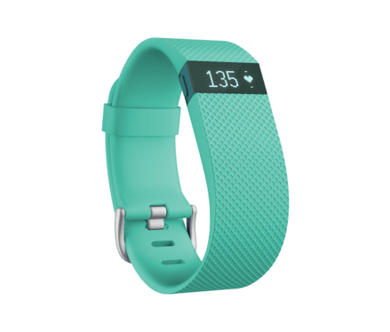
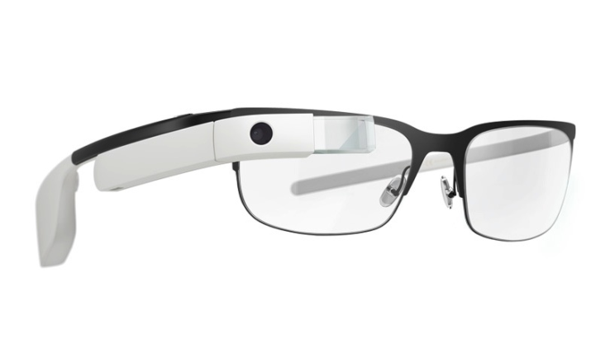
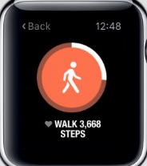
Wearable computing
→ more data
???
Notes:
Talking of wearable computing, most of people will think of these low data rate sensing devices such as fitbit.
This is because they enabled many wide-spread applications and most of them measure the body motion such as pedometer.
But people now are adding high data rate sensors such as cameras to wearables.
So Looking into the future in wearable computing, applications are required to process more data at real time,
which puts more pressure on the system resource
In this paper, we’re investigating what kind of infrastructure is required to support the workload for camera-based wearable devices.
But before I go into the details about the problem, let me first give a few tastes of what kind of apps we can provide.
Notes:
The phase of todays Wearable computing is low-data rate sensing devices
the killer application is things measured body motion like pedometer
but in this paper, we’re looking towards to the wearable devices in the future. which once you go from low data
what’s the infrastructure to support camera-based
let me first give a few taste of what app we can enable

Slide 3

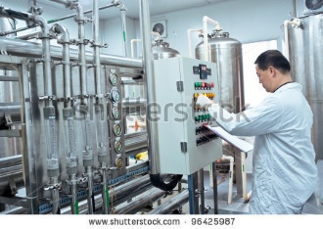
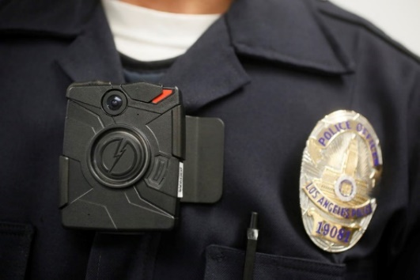
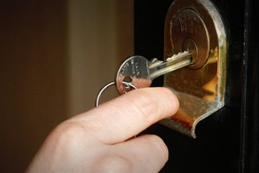

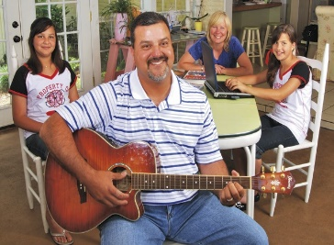
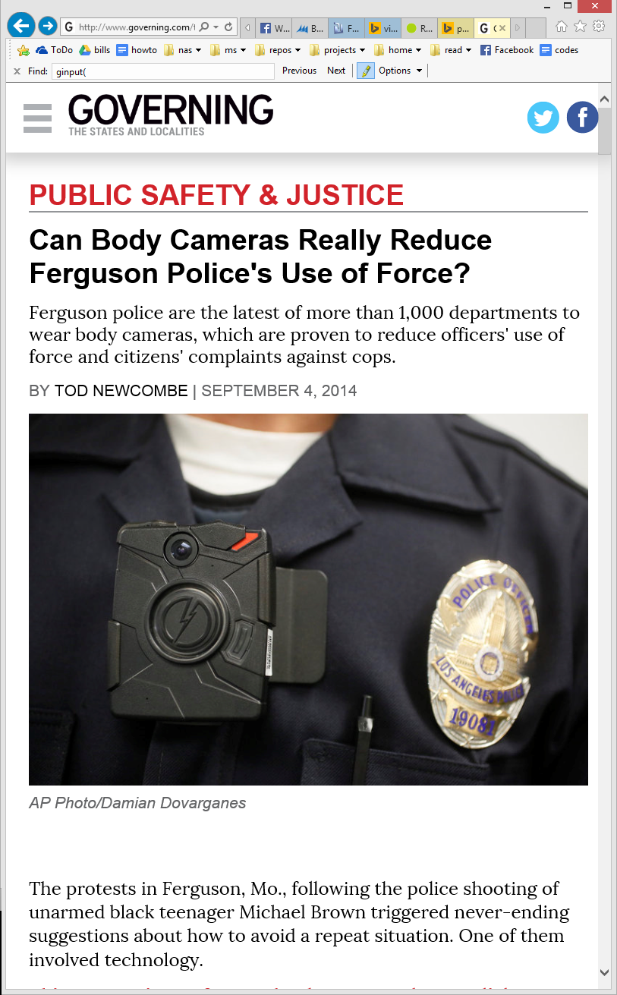
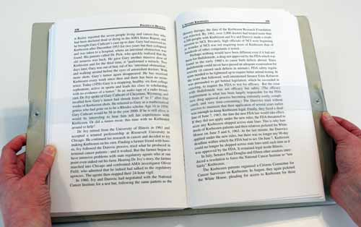

When computer vision meets wearable
“That drink will get you to 2800 calories for today”
“I last saw your keys in the store room”
“Remind Tom of the party”
“You’re on page 263 of this book”
Consumer
Manufacturing
Public Safety
Notes:
After we combine the computer vision with camera-based wearable, we can think of many useful application for both consumers that you and I can use every day, and for enterprise that can be used in the work place
At the consumer side, if your cameras can see what you do, a bunch of magical things can happen
For example, it can tell you where you left your keys.
in the manufacturing side, studies show more than 80 percent of failures come from human.
If wearable devices can monitor human mistakes, it can give us real time help and prevent the mistakes from happening
Very similarly, police officers now carry the body cameras during the patrol.
However these videos are simply recorded to prevent anything bad happen
If we can identify the wanted people and the license plates at real time from the video stream, these body cameras will be much more useful.
In summary, there are whole bunch of possibilities that we can do with the wearable cameras.
However, people may ask, does computer vision really work for the real world?

Slide 4
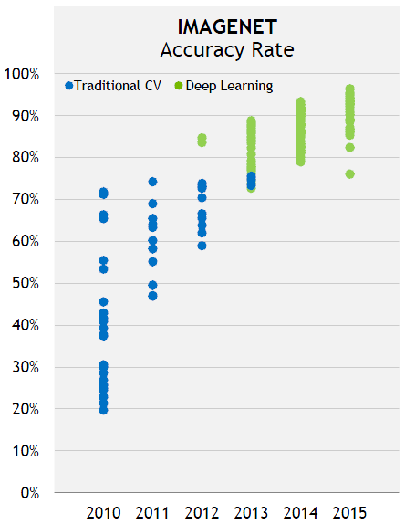
Deep learning makes vision work
But...
Recognition Task | face | scene* | object*
Accuracy | 97% | 88% | 92%
Compute/frame (FLOPs) | 1.00G | 30.9G | 39.3G
Compute@1-30fps (FLOPS) | 1-30G | 30-900G | 40G-1.2T
Do we have enough resources to run deep learning?
* top-5 accuracy is shown in the table
Notes:
In recent years, deep learning becomes the revolutionary technique that changed the computer vision.
The graph shows that the accuracy of object recognition has been increasing rapidly after we adopt the deep neural network,
and now machines are almost as good as humans at object recognition.
But, although deep learning makes the computer vision more accurate, they are also known to be very compute intensive.
This table shows one of the best recognition models for face/scene/object recognition.
Notice that these models require 1 to 40 GFLOPS to execute.
What’s worse is that this is the computation for only one single frame.
If we apply the deep learning to a video stream at 1-30fps, the workload can be up to 1.2 trillion flops per second.
So do we have enough resources to run this for the mobile execution environment?
Let me give you more details of the resource usage.

Slide 5
Resource usage for continuous vision
Qualcomm SD810 LTE
>800mW
Atheros 802.11 a/g
15Mbps@700mW= 47nJ/b
Amazon EC2
CPU c4.large 2x400GFLOPS $0.1/h
GPU g2.2xlarge 2.3TFLOPS $0.65/h
Omnivision
OV2740
90mW
Tegra K1 GPU
290GOPS@10W
= 34pJ/OP
Cloud
Imager
Processor
Radio
Workload | Deep learning 300GFLOPS @ 30GFLOPs/frame, 10fps
Budget | Device power | Cloud cost
 | 30% of 10Wh for 10h = 300mW | $10 person/year
Compute power | 9GFLOPS | 3.5GFLOPS (GPU) / 8GFLOPS (CPU)
Huge gap between workload and budget
Notes:
In a typical end-to-end mobile system. It consists of a mobile device component and cloud component.
The mobile device has an imager that takes in the video stream, a processor that can perform some computation, and a radio for communication with cloud.
For these heavy workload the computation can be also offloaded to the cloud.
Suppose the video frame is 10 fps and each frame requires 30 GFLOPs for recognition
Then total computation demand is 300 GFLOPs per second.
On the other hand, looking at the budget we have.
Suppose battery capacity of a mobile device is 10Wh, and our target of this new application is 30% of total capacity and running for 10h,
therefore we can sustain 300mW as our power budget.
On the cloud side, our target cost is $10 per person per year.
Based on the energy consumption on the mobile devices and computation cost in the cloud.
Then we translate the budget to the compute power that can be achieve.
In fact we can get at most 9GFLOPS at mobile devices and 4-8 GFLOPS in the cloud depending on CPU or GPU instance.
Compared to the workload, there’s a 2 order of magnitude gap between the deep learning workload and budget.
So in this paper, our goal is to bridge this gap to make deep learning feasible.
At this point, we have to learn how the deep learning works.

Slide 6
Neural network
classes + scores
m
c
r
r
s
c
c
f
m
r
r
r
c
f
c
r
r
img_{R} img_{G} img_{B}
m
f
(c) convolution
(f) fully connect
(m) max pool
(r) relu
(s) softmax
Notes:
The figure shows an example of a neural network.
A NN can be viewed as a dataflow graph where each node, or layer, performs some array-processing operations.

Slide 7

Neural network $≈$ matrix multiplications
classes + scores
m
c
x
x
x
r
r
s
c
c
f
m
r
r
Low rank approximation (Y. Kim, et al. 2016)
r
c
f
c
r
r
c
r
classes + scores
img_{R} img_{G} img_{B}
m
f
m
m
x
(c) convolution
(f) fully connect
(m) max pool
(r) relu
(s) softmax
r
c
s
c
r
f
img_{R} img_{G} img_{B}
f
r
Matrix sparsification
(S. Han, et al. 2015)
Architectural changes
(J. Ba, et al. 2014)
Notes:
Look inside each layer, the operations are mostly matrix multiplications.
Researchers have been working on reducing both memory and computation cost of the neural networks.
Since they’re matrix multiplications, we can use the standard methods to compress them.
First, we can apply SVD to the matrices and use low rank approximation to reduce the size of matrices and the total computation.
Second, we can sparsify the matrix by zeroing very small values and use low-bitwidth floating numbers.
Third, we can directly modify the architecture of the neural network model, and reduce the number of layers and size of weight matrices.
although these approaches can substantial reduce the resource use of neural network,
they have different effects in terms of the tradeoff between accuracy and resource use.
From the system perspective, we need to understand and manage these tradeoff, and schedule the approximate models at the runtime under all sorts of budgets and constraints.

Slide 8
Managing the approx. / resource trade-off
Detailed characterization of the approximation / resource trade-off for many optimizations
Two new optimizations for streaming, multi-application settings
New scheduling problem, Approximate Model Scheduling, with a heuristic solution
Notes:
In essence, what we did in this paper is managing the tradeoff between approximation and resource use
More specifically, we did the following three things.
First we categorize the approximation and resource tradeoff from different aspects for many optimizations
Second, we find two new optimizations for streaming and multi-application settings to have better accuracy and resource trade-off
Third, we need to dynamically select a right version of approximate models under the budgets.
we formulate this problem as AMS, and we come up with a heuristic solution to this

Slide 9
Outline
Detailed characterization of the approximation / resource trade-off for many optimizations
Two new optimizations for streaming, multi-application settings
New scheduling problem, Approximate Model Scheduling, with a heuristic solution
Notes:
I will give a flaovr of detailed categorization the approx & resource tradeoff

Slide 10
Memory / accuracy trade-off
Notes:
Let’s first focus on the memory and accuracy tradeoff.
The x-axis is accuracy, y-axis is memory in log scale.
in this graph we have one unoptimized model for obj/scene/face recognition

Slide 11
Memory / accuracy trade-off
Substantially reduce memory use with gradual accuracy loss
Notes:
Then We generated 10 to 60 approximate models for each task using the methods as mentioned before
Here I only show a subset of data points.
One take away from here is that we can substantially reduce resource with very gradual accuracy loss

Slide 12
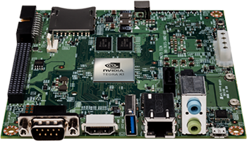
Energy / accuracy trade-off
Exceed energy budget when execute locally
Nvidia Jetson TK1
Compute energy budget (2.3J)
Can execute locally under energy budget
LTE xmit cost (0.9J)
Always execute locally
Wifi xmit cost (0.5J)
energy budget = total energy / total time(10h) / requests per second(1 req/sec)
Notes:
Next let’s take a look at the energy and accuracy tradeoff.
x-axis is accuracy, y-axis is energy consumption
we measured the energy consumption of these neural network models on the nvidia jetson board.
Lower two horizontal lines show the energy consumption if transmitting an image to the cloud through LTE or Wifi.
Third line show the energy budget that allows to compute for each request.
This energy budget is calculated statically, but at the runtime, it will vary according to the workload.
We can then categorize the models into three classes.
For these smallest models, we should always execute them locally because transmission costs more energy
I won’t show the cost and accuracy trade-off here due to the time limit. But you can read the paper to see that.
Notes:
mention the energy budget varies during the runtime

Slide 13
Outline
Detailed characterization of the approximation / resource trade-off for many optimizations
Two new optimizations for streaming, multi-application settings
Specialization
Model sharing
New scheduling problem, Approximate Model Scheduling, with a heuristic solution
Notes:
Previously we have seen the existing optimizations on NN.
Besides, We also find two new optimizations for streaming, multi-application settings.

Slide 14
Exploiting stream locality by specialization
Standard deep neural network recognizes 4000 people
Most of videos are dominated by less than 10 faces over minutes
Timeline
Produce more compact models for skewed classes
Notes:
speciali
let’s consider perform face recognition in the video, a standard model can recognize 4000 faces
However most of faces come from a small subset of classes within a few minutes
For example, if I’m meeting with my colleagues, I’ll mostly see three persons for a certain period of time.
Specialization is to produce more compact models for skewed classes in the video context

Slide 15
Specialization runtime
class
class
full model
full model
check for “other”
class
compact model
input
input
(with skewed distribution)
Notes:
to utilize the specialization, we devised the following run time system
by default, we use the full model to serve requests.
Once it detects the temporal skew in video stream, runtime will generates a specialized model for skewed classes
After that, in most cases, it utilizes the specialized model. But when compact model predicts the input outside of skewed classes, system will fall back to the full model for recognition.

Slide 16
Better resource/accuracy trade-off
Notes:
now let’s look at the accuracy and resource tradeoff in the specialization
I pick one compact model shown before for each task and compare them with the full model in accuracy
typically, a compact model loses accuracy compared to full model if running on the same general distribution.
But in fact we only need to use compact models on the skewed classes
And when the compact models are used to recognize 7 classes, their accuracy are even higher than the full models.
Then looking at the energy consumptions, these compact models consume 1-2 order of magnitude less energy than the full models.

Slide 17
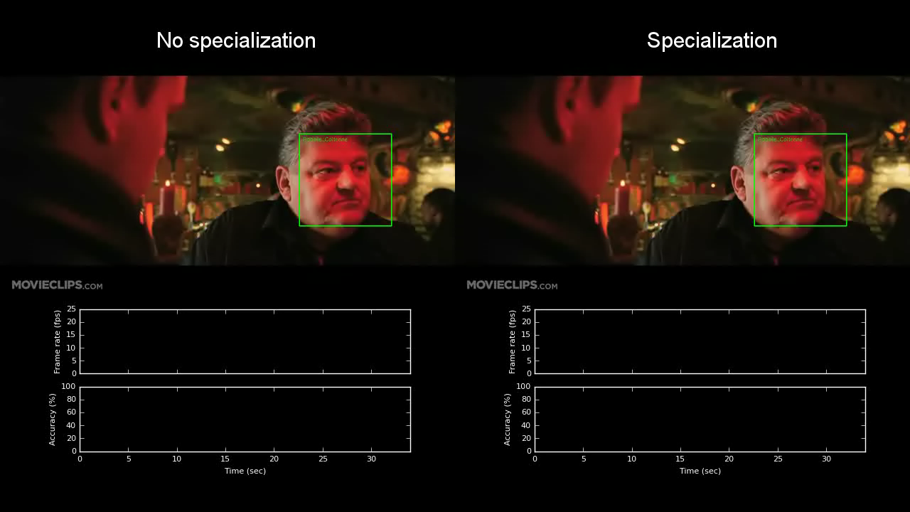
Notes:
Let me show a video demo when we apply specialization to recognize actors in videos.
On the left side, it uses the full model without specialization; while on the right side, it uses specialization.
At the bottom, we show the frame rate and accuracy per second.
(start the video)
We can see that using the full model , the frame rate is only about 14 fps.
However, the system quickly detects temporal context and generates a specialized model to reduce the latency WHILE still MAINTAINING ACCURACY.
After that the frame rate increases to 24 fps. and the runtime system can also detect the context change
Overall, the specialization achieves higher frame rate and accuracy.
Notes:
- setup the video first before playing the video

Slide 18
Outline
Detailed characterization of the approximation / resource trade-off for many optimizations
Two new optimizations for streaming, multi-application settings
New scheduling problem, Approximate Model Scheduling, with a heuristic solution
Notes:
now let’s look at the scheduling problem that decides which approximate models to use at run time.

Slide 19
Approximate model scheduling
Task 1
Task 2
memory
Model Pool
model 1 (90%)
model 2 (80%)
model 3 (80%)
model 4 (70%)
energy
8
2
2
5
1
1
9
3
3
6
2
2
cost
Mobile device
Energy 14
Memory 10
Cost 14
Cloud
Goal: maximize the overall accuracy
Accuracy
Notes:
Before I explain the details, Let me walk you through some simple examples.
Suppose we have two models for each task, one is the full model which has higher accuracy and requires more resource,
the other is compact model which is less accurate and also consumes less resource.
For example, the accuracy of model 1 is 90% while it requires 8 units of memory, 2 units of battery if execute on mobile device and 2 units of cash if executed in the cloud
Next we can have certain resource budgets and constraints for the system. Suppose the energy budget on mobile device is 14, memory limit is 10, and cost budget in the cloud is 14.
Our goal is to maximize the overall accuracy.

Slide 20
Approximate model scheduling
Task 1
Task 2
memory
Model Pool
model 1 (90%)
model 2 (80%)
model 3 (80%)
model 4 (70%)
energy
8
2
2
5
1
1
9
3
3
6
2
2
cost
Energy 14
Memory 10
Mobile device
model 4
model 4
Cost 14
Requests:
task 1
task 2
task 1
task 1
task 2
model 1
model 1
m2
Packing problem
Cloud
→ cloud, model 1
→ device, model 4
→ cloud, model 1
→ cloud, model 2
Accuracy
→ device, model 4
1
2
3
4
5
Notes:
Now let’s focus on the energy and cost budget.
We may receive many requests for either task 1 or task 2.
For each request, we can choose to use either the full model for higher accuracy, or compact model for less resource use.
And we can choose to run on the device or in the cloud.
But Over all the time, we have a upper bound for energy consumption and cost budget
So here we can frame it as a packing problem.
What’s interesting here, normally there is only one place to pack the models, but here we have two.

Slide 21
Approximate model scheduling
Task 1
Task 2
memory
Model Pool
model 1 (90%)
model 2 (80%)
model 3 (80%)
model 4 (70%)
energy
8
2
2
5
1
1
9
3
3
6
2
2
cost
Energy 14
Memory 10
Mobile device
model 4
model 4
model 4
model 2
Cost 14
Requests:
task 1 → cloud, model 1
task 2 → device, model 4
task 1 → cloud, model 1
task 1 → cloud, model 2
task 2 → device, model 4
task 1
model 1
model 1
m2
Cloud
Paging problem
Accuracy
1
2
3
4
5
Notes:
Next let’s focus on the memory constraints on the device.
Suppose we’ve already loaded model 4 in the memory of the device,
at this point, the device loses the internet connection, so all the subsequent requests must be executed on the device.
However, when it receives a new request for task 1, we find that the device doesn’t have enough memory for even the compact model,
Therefore, we need to evict the cached model from the memory in order to serve the request.
In fact we’re facing the weighted paging problem for the memory constraints

Slide 22
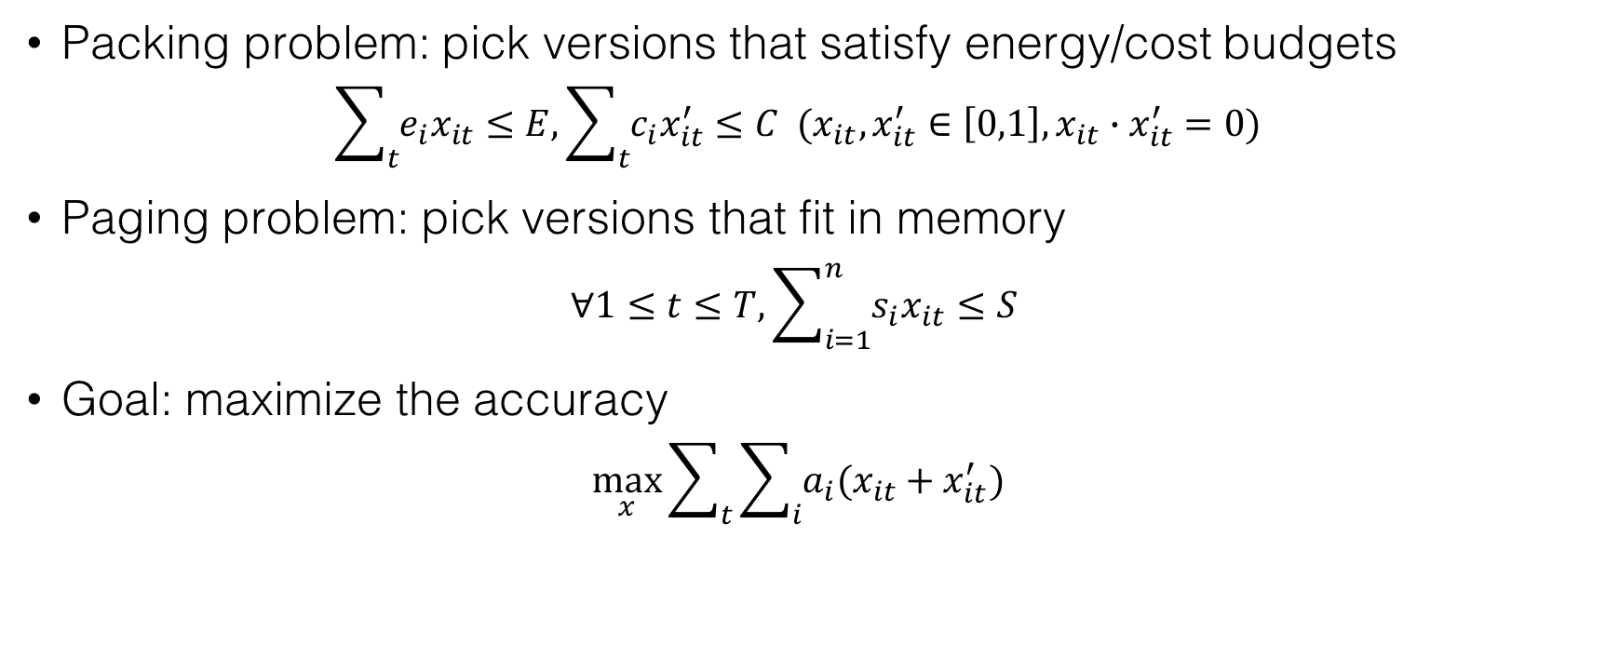
Approximate model scheduling
Packing problem: pick versions that satisfy energy/cost budgets $\sum_{t}{e_{i}x_{it}}≤E, \sum_{t}{c_{i}x_{it}^{′}}≤C (x_{it},x_{it}^{′}∈\left[0,1\right], x_{it}∙x_{it}^{′}=0)$
Paging problem: pick versions that fit in memory $∀1≤t≤T,\sum_{i=1}^{n}{s_{i}x_{it}}≤S$
Goal: maximize the accuracy $\max_{x}{\sum_{t}{\sum_{i}{a_{i}(x_{it}+x_{it}^{′})}}}$
No known optimal online algorithms
Notes:
In summary, the approximate model scheduling problem is a joint packing and paging problem.
Overall all the time, we need to pick versions that satisfy energy and cost budgets
At each time step, we also need to fit models in the device memory.
For each single problem we already know there’s an optimal algorithm to solve it.
for this joint problem, there is no known optimal online algorithms to solve this.

Slide 23
Heuristic scheduler
Estimate future resource use and compute the budget for each request
Account for paging cost to reduce oscillations
Use increasingly more accurate versions of more heavily used models
Notes:
We come up with a heuristic scheduling algorithm.
There are three key points to the algorithm
First, we need to estimate future resource use and
Here E and C is the remaining energy and cost budget, T is the remaining time, f_n is the estimated frequency for model n
Then, we can computes the energy and cost budget on the mobile device or in the cloud to serve this request
Based on these, we select the best models under the constraints.
If we execute the model in the mobile device, we also need to discount the paging cost in order to prevent the oscillation of switching models in and out.
Third, we will also backing in more accurate models if we have enough budget in the future.

Slide 24
Trace-driven evaluation
Lose connectivity
Run out of battery
Notes:
To evaluate our system, we performed the trace-driven experiments.
We generated the synthetic connectivity trace on mobile phones shown in the bottom panel.
We applied the workload of face analysis including the id, gender, age, and race recognition. we also run scene recognition as a second application.
The workload lasts for 10h.
We compared the MCDNN to two straw man strategies which only uses the device or the cloud
we can see that if we only use device, it will run out of battery budget before 10 hours
But if we only use the cloud, the requests are not served when losing the connectivity.
However, MCDNN achieves good accuracy and makes the trade-offs necessary to keep running through the day.
scene: 1 req / 30 sec
face: 1 req / 5 sec

Slide 25
MCDNN framework
input type model schema
training/validation data
compiler
trained model
catalog
development time
run time
input
device runtime
scheduler data router
input
cloud runtime
scheduler data router
profiler
classes
classes
apps
device
cloud
Notes:
In summary,
MCDNN has a static compiler which generates approximate neural network models and categorize the tradeoff during the development time.
(click)
It consists of a device runtime and cloud runtime.
The device runtime receives recognition requests from multiple applications running on the mobile device.
A heuristic scheduler selects an approximate model and executes it either on the mobile device or in the cloud based on the remaining power and cost budget.
(click)
MCDNN also has runtime optimization such as specialization which detects the temporal context in the video stream and quickly generates specialized models during the runtime.
(30’)

Slide 26
MCDNN framework
input type model schema
training/validation data
compiler
trained model
catalog
development time
specialization time
specializer
run time
specialized models
stats
input
device runtime
scheduler data router
input
cloud runtime
scheduler data router
profiler
classes
classes
apps
device
cloud
Notes:
MCDNN has a compiler which generates approximate neural network models and categorize the tradeoff between accuracy and resource use.
(click)
The device runtime receives recognition requests from multiple applications running on the mobile device.
A heuristic scheduler selects an approximate model and executes it either on the mobile device or in the cloud based on the remaining power and cost budget.
(click)
Further, MCDNN has a specializer which detects the temporal context in the video stream and quickly generates more light-weight models during the runtime.
(30’)

Slide 27
Conclusion
MCDNN makes efficient trade-offs between resource use and accuracy
Formulate the approximate model scheduling problem and devise a heuristic algorithm
Design a generic approximation-based execution framework for continuous mobile vision
Thank you! Questions?

Slide 28
Backup Slides

Slide 29
Cloud cost / accuracy trade-off
cloud CPU latency budget (7645ms)
@ $10/yr, 1 request/min
@ AWS c4.large
cloud GPU latency budget (582ms)
@ $10/yr, 1 request/min
@ AWS g2.2xlarge
cloud GPU latency budget (9.7ms)
@ $10/yr, 1 request/s
@ AWS g2.2xlarge
latency budget = cost budget / cost per hour / #requests
Notes:
Now let’s focus on the cost for execution in the cloud
we translate the cloud cost budget to latency budget
we divide cost budget by cost per hour and number of total queries, which becomes the latency budget we have for each request
for smaller models we can afford the request rate at 1 req/s
for larger model, we need to reduce the request rate, to 1 req/min for example
Notes:
- transition to next slide

Slide 30
Model sharing
Notes:
Second, we find that a single user runs several applications at the same time.
for example, she runs face ID apps and meanwhile another app needs to recognize the gender,
we can share the bottom layers between face ID model and gender model, which can save lots of computation

Slide 31
Dynamically-sized caching scheme

